Slide 1
Historical Overview of Snow Crab Survey Station Relocations
by Tobie Surette
DFO Peer Review Process, 2020

Slide 2
Background:
The practice of relocating survey stations to alternate locations when trawl is damaged implies that survey stations concentrate in trawlable areas over time (Peer review process, 2019).
DFO Peer Review Process, 2020
Notes:
So when we have trawl damage during the survey, the current practice is to relocate to a randomly-selected alternate station.
- Even though the alternates are randomly selected, stations located in grids with rough bottoms will tend to be relocated until softer bottom is encountered

Slide 3
Station relocations:
This is an issue if:
crab have different densities between trawlable versus less trawlable bottoms.
crab have different catchabilities between trawlable versus less trawlable bottom.
DFO Peer Review Process, 2020
Notes:
So if trawlable bottoms are associated with different habitats, which result in different average densities, or that crab catchability varies between the two types of bottom, the observed densities may change as a result.

Slide 4
Methods:
Order and time of appearance of new survey stations over the history of the survey was determined.
Number of stations relocations by survey grid and the total by year since the last survey redesign in 2013 was calculated.
Crab density trends among relocated versus fixed stations was compared.
DFO Peer Review Process, 2020

Slide 5
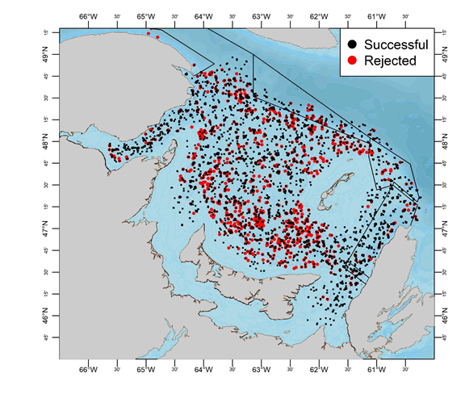
Locations of rejected survey tows:
Trawlable areas:
Chaleur Bay.
Shediac Valley
Bradelle Banks.
Western Cape Breton.
Zone 12F.
Rejected tows:
North of PEI.
Eastern and Western edge of Shediac Valley.
Shallow edge of Laurentian Channel.
Locations of successful (black) and rejected (red) snow crab survey tows.

Slide 6
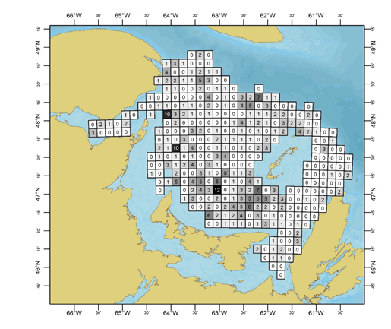
Relocations per survey grid:
Grids in problematic trawling areas contain multiple relocations.
Fixed stations are concentrated in certain areas.
Number of survey station relocations per survey grid from 2013 to 2019.
Notes:
So these are the grids which are currently used in our trawl survey
Note that these are not the same 10x10 minute grids which are used for fishery stats.
There are 355 grids, each with a single station within it
Grids are shaded by the number of times their stations have been relocated to alternate stations over the period from 2013 to 2019.

Slide 7
Station Relocations since 2013:
Number of survey grids having undergone 0, 1, 2, 3 or 4 or more survey stations relocations since 2013.
Year | 0 | 1 | 2 | 3 | 4+
2013 | 288 | 57 | 9 | 1 | 0
2014 | 261 | 75 | 13 | 6 | 0
2015 | 237 | 79 | 25 | 12 | 2
2016 | 226 | 77 | 28 | 16 | 8
2017 | 217 | 76 | 26 | 25 | 11
2018 | 206 | 76 | 30 | 29 | 14
2019 | 195 | 78 | 28 | 28 | 26
2020 | 186 | 80 | 33 | 29 | 27

Slide 8
Survey Station Relocation History:
~2000 station locations in total.
Almost 10000 tows in all.
1991 new stations.
2006 new stations and retention of older stations.
2006-2011: only fixed stations.
2012: New design and stations.
2013: New design and stations.
2013-2020: Almost half of original survey stations have been relocated.

Slide 9
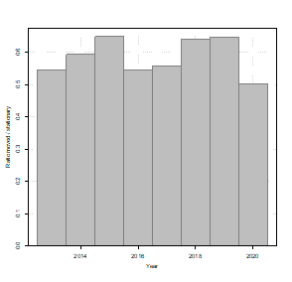
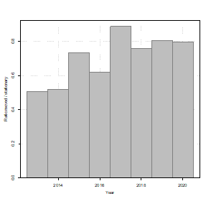
Relocated versus fixed density trends:
Mature females
Commercial males
No trend
Increasing trend
Increasing trend among instar VIII recruits (not shown)
Notes:
This graph compares the densities among grids which have sustained station relocations, versus those whose stations have remained fixed.
So for mature females, crab densities among relocated grids was about 60% that of fixed stations over the period from 2013 to 2020.
Among commercial males, the relative proportion has increased has increased over the same period from about 50% to about 80%.
Similar increases were observed among instar VIII crab, which are used as indictors of population recruitment.
Although these increases may indicate a certain favouring of commercial and recruits as more and more stations are relocated through time, the fluctuations may also be due to:
Normal population fluctuations
So this leads to a research recommendation, that 100 representative stations be selected among the original set of 2013 survey stations.

Slide 10
Summary:
Almost half of survey grid sampling stations have been moved since 2013.
Number of rejected tows per year decreases over time.
Tows progressively relocated to more trawlable bottom in certain areas.
Increase in relative snow crab densities among commercial males and instar VIII recruits, but not among matures females.

